Slide 1
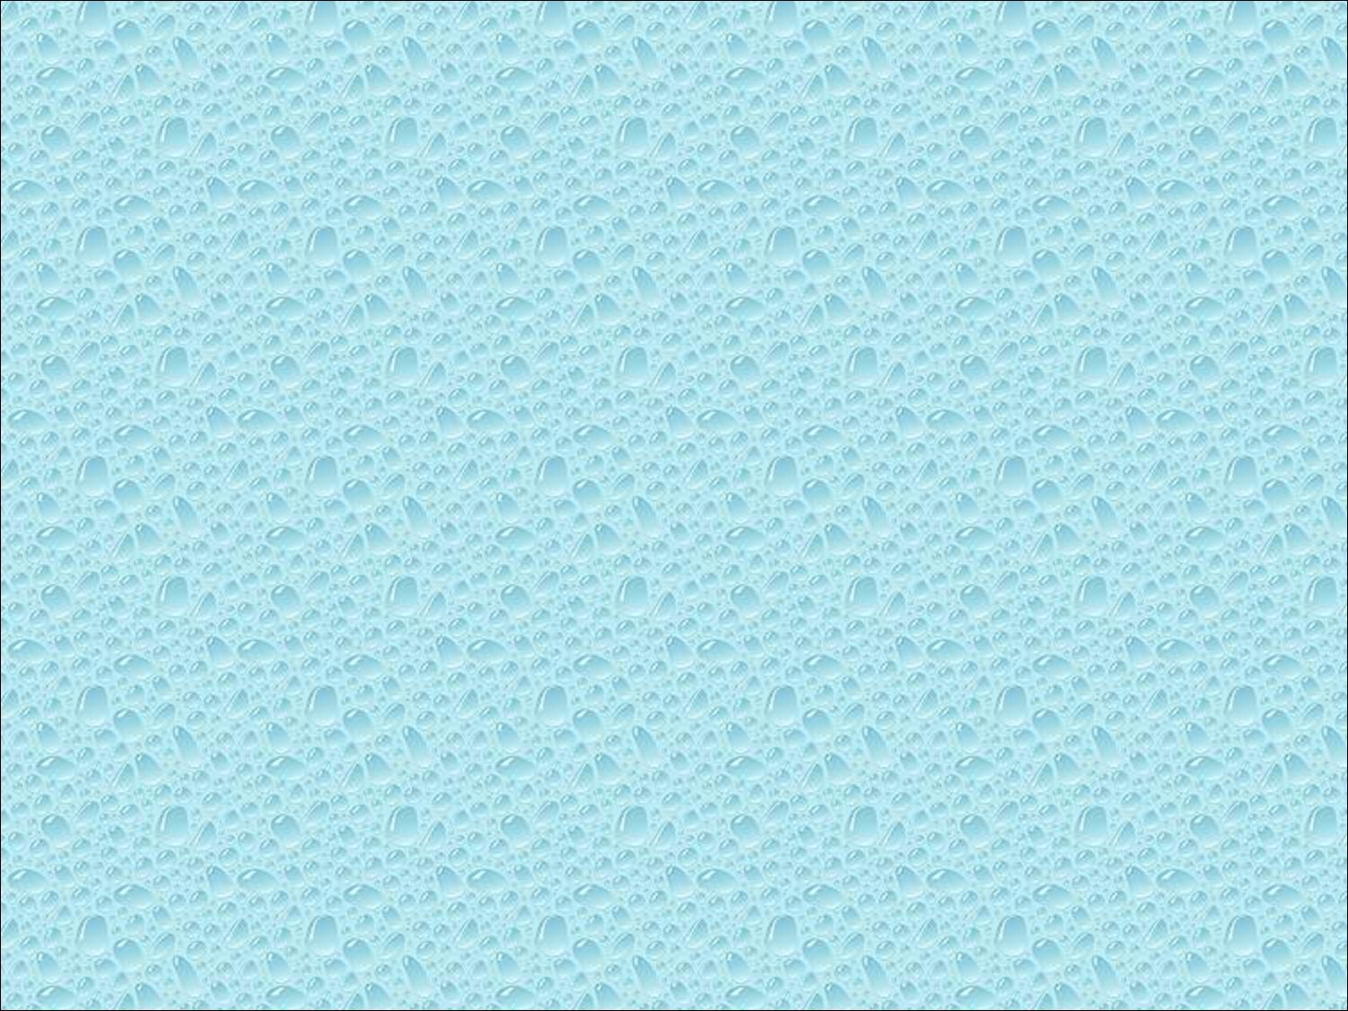

Part 3: Three Dimensions

Slide 2

Develop a more sophisticated three-dimensional example
  Sierpinski gasket: a fractal
Introduce hidden-surface removal

Slide 3

In OpenGL, two-dimensional applications are a special case of three-dimensional graphics
Going to 3D
  Not much changes
  Use glVertex3*( )
  Have to worry about the order in which polygons are drawn or use hidden-surface removal
  Polygons should be simple, convex, flat

Slide 4

The construction proceeding:
Giving three points are not collinear
  Pick an initial point (x, y, z) at random inside the triangle
  Select one of the three vertices at random
  Find the location halfway between the initial point and the random selected vertex
  Display this new point
  Replace the point at (x, y, z) with the new point
  Return to Step 2

Slide 5

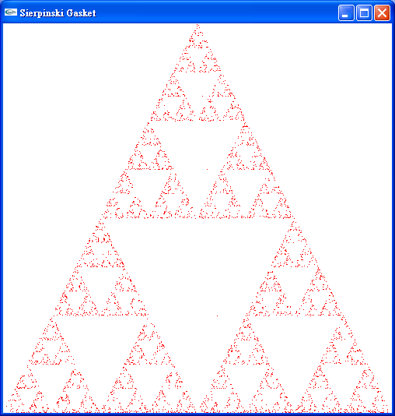

Slide 6

Start with a triangle
Connect bisectors of sides and remove central triangle
Repeat

Slide 7

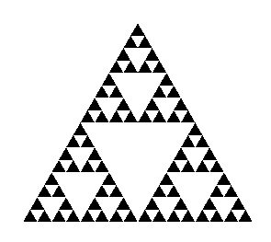
Five subdivisions

Slide 8

Consider the filled area (black) and the perimeter (the length of all the lines around the filled triangles)
As we continue subdividing
  the area goes to zero
  but the perimeter goes to infinity
This is not an ordinary geometric object
  It is neither two- nor three-dimensional
It is a fractal (fractional dimension) object

Slide 9

#include <GL/glut.h>
/* initial triangle */
GLfloat v[3][2]={{-1.0, -0.58},
{1.0, -0.58}, {0.0, 1.15}};
int n; /* number of recursive steps */

Slide 10

void triangle( GLfloat *a, GLfloat *b, GLfloat *c)
/* display one triangle */
{
glVertex2fv(a);
glVertex2fv(b);
glVertex2fv(c);
}

Slide 11

void divide_triangle(GLfloat *a, GLfloat *b, GLfloat *c, int m)
{
/* triangle subdivision using vertex numbers */
point2 v0, v1, v2;
int j;
if(m>0)
{
for(j=0; j<2; j++) v0[j]=(a[j]+b[j])/2;
for(j=0; j<2; j++) v1[j]=(a[j]+c[j])/2;
for(j=0; j<2; j++) v2[j]=(b[j]+c[j])/2;
divide_triangle(a, v0, v1, m-1);
divide_triangle(c, v1, v2, m-1);
divide_triangle(b, v2, v0, m-1);
}
else(triangle(a,b,c));
/* draw triangle at end of recursion */
}

Slide 12

void display()
{
glClear(GL_COLOR_BUFFER_BIT);
glBegin(GL_TRIANGLES);
divide_triangle(v[0], v[1], v[2], n);
glEnd();
glFlush();
}
void myinit()
{
glMatrixMode(GL_PROJECTION);
glLoadIdentity();
gluOrtho2D(-2.0, 2.0, -2.0, 2.0);
glMatrixMode(GL_MODELVIEW);
glClearColor (1.0, 1.0, 1.0,1.0)
glColor3f(0.0,0.0,0.0);
}

Slide 13

int main(int argc, char **argv)
{
n=4;
glutInit(&argc, argv);
glutInitDisplayMode(GLUT_SINGLE|GLUT_RGB);
glutInitWindowSize(500, 500);
glutCreateWindow(“2D Gasket");
glutDisplayFunc(display);
myinit();
glutMainLoop();
}

Slide 14

By having the glBegin and glEnd in the display callback rather than in the function triangle and using GL_TRIANGLES rather than GL_POLYGON in glBegin, we call glBegin and glEnd only once for the entire gasket rather than once for each triangle

Slide 15

We can easily make the program three-dimensional by using
  GLfloat v[3][3]
  glVertex3f
  glOrtho
But that would not be very interesting
Instead, we can start with a tetrahedron

Slide 16

We can subdivide each of the four faces
Appears as if we remove a solid tetrahedron from the center leaving four smaller tetrahedra

Slide 17
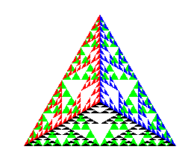
after 5 iterations

Slide 18

void triangle( GLfloat *a, GLfloat *b, GLfloat *c)
{
glVertex3fv(a);
glVertex3fv(b);
glVertex3fv(c);
}

Slide 19

void divide_triangle(GLfloat *a, GLfloat *b, GLfloat *c, int m)
{
GLfloat v1[3], v2[3], v3[3];
int j;
if(m>0)
{
for(j=0; j<3; j++) v1[j]=(a[j]+b[j])/2;
for(j=0; j<3; j++) v2[j]=(a[j]+c[j])/2;
for(j=0; j<3; j++) v3[j]=(b[j]+c[j])/2;
divide_triangle(a, v1, v2, m-1);
divide_triangle(c, v2, v3, m-1);
divide_triangle(b, v3, v1, m-1);
}
else(triangle(a,b,c));
}

Slide 20

void tetrahedron( int m)
{
glColor3f(1.0,0.0,0.0);
divide_triangle(v[0], v[1], v[2], m);
glColor3f(0.0,1.0,0.0);
divide_triangle(v[3], v[2], v[1], m);
glColor3f(0.0,0.0,1.0);
divide_triangle(v[0], v[3], v[1], m);
glColor3f(0.0,0.0,0.0);
divide_triangle(v[0], v[2], v[3], m);
}

Slide 21

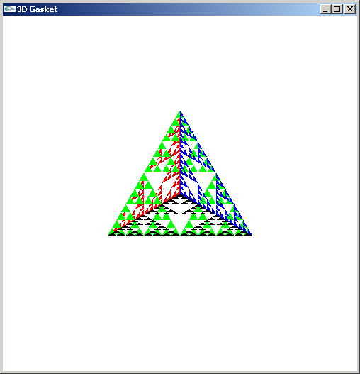
Because the triangles are drawn in the order they are defined in the program, the front triangles are not always rendered in front of triangles behind them
get this
get this
want this
want this

Slide 22

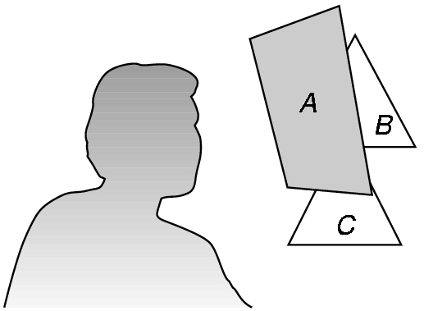
We want to see only those surfaces in front of other surfaces
OpenGL uses a hidden-surface method called the z-buffer algorithm that saves depth information as objects are rendered so that only the front objects appear in the image

Slide 23

The algorithm uses an extra buffer, the z-buffer, to store depth information as geometry travels down the pipeline
It must be
  Requested in main.c
    glutInitDisplayMode
    (GLUT_SINGLE | GLUT_RGB | GLUT_DEPTH)
  Enabled in init.c
    glEnable(GL_DEPTH_TEST)
  Cleared in the display callback
    glClear(GL_COLOR_BUFFER_BIT |
    GL_DEPTH_BUFFER_BIT)

Slide 24

In our example, we divided the surface of each face
We could also divide the volume using the same midpoints
The midpoints define four smaller tetrahedrons, one for each vertex
Keeping only these tetrahedrons removes a volume in the middle
See text for code

Slide 25

